Slide 1
Name:Shravani Jalli
Email:shravanijalli@gmail.com
Project ID: SPS_PRO_101

Slide 2
Smart Agriculture System based on IOT
The global population is predicted to touch 9.6 billion by 2050 – this poses a big problem for the agriculture industry.
Despite combating challenges like extreme weather conditions, rising climate change, and farming’s environmental impact, the demand for more food has to be met.
To meet these increasing needs, agriculture has to turn to new technology.
In IoT-based smart farming, a system is built for monitoring the crop field with the help of sensors (light, humidity, temperature, soil moisture, etc.) and automating the irrigation system.
The farmers can monitor the field conditions from anywhere. IoT-based smart farming is highly efficient when compared with the conventional approach.
The applications of IoT-based smart farming not only target conventional, large farming operations, but could also be new levers to uplift other growing or common trends in agricultural like organic farming, family farming.

Slide 3
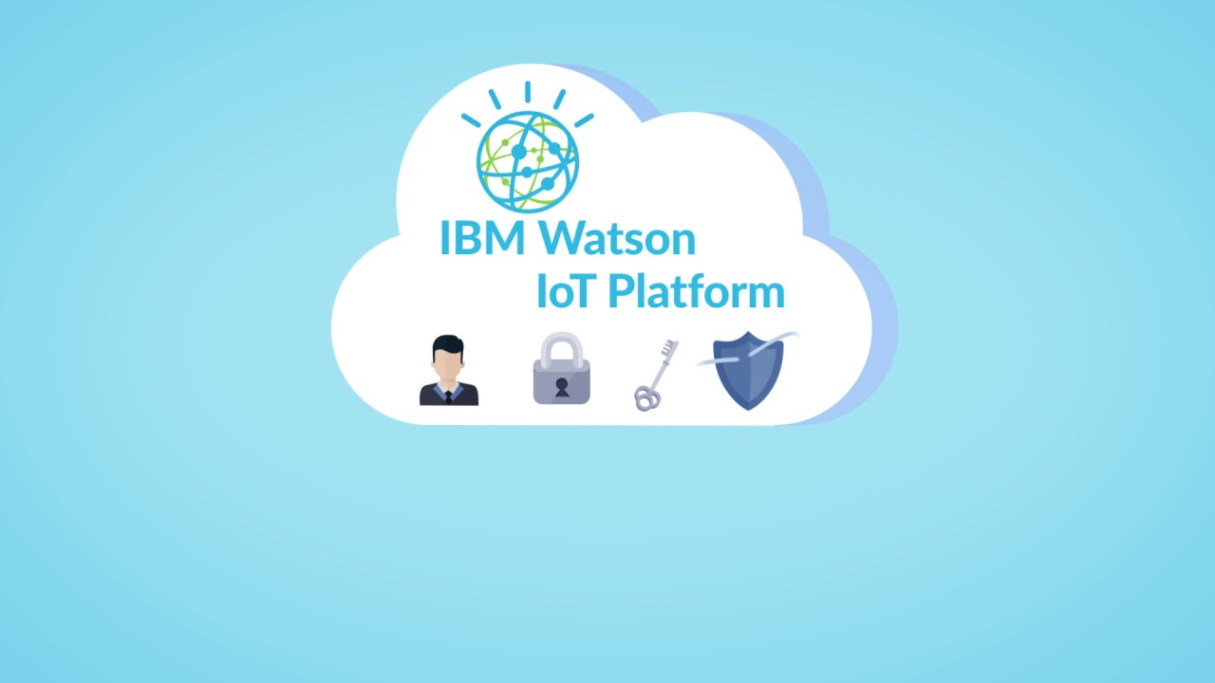
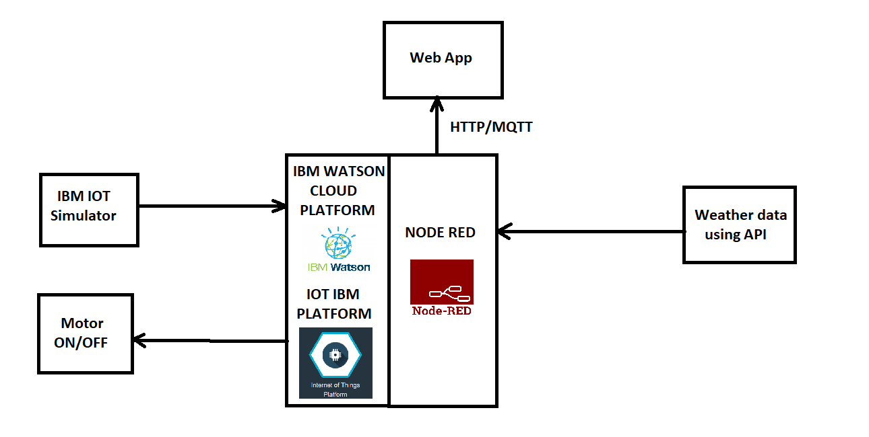
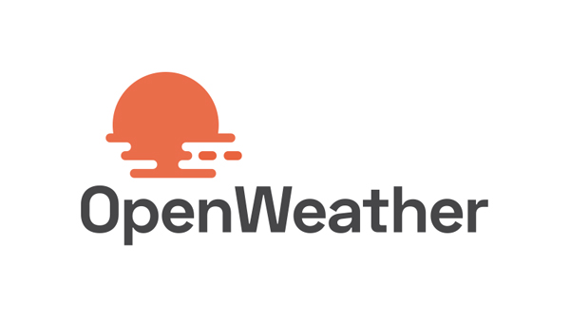

Block Diagram
“Smart Agriculture System based on IOT is done with the cloud platform.We use IBM Watson Iot platform,Open weather API and Node-Red.”

Slide 4
Future Scope:
IoT in agriculture technologies comprise specialized equipment, wireless connectivity, software and IT services.
BI Intelligence survey expects that the adoption of IoT devices in the agriculture industry will reach 75 million in 2020, growing 20% annually. At the same time, the global smart agriculture market size is expected to triple by 2025, reaching $15.3.
Smart farming based on IoT technologies enables growers and farmers to reduce waste and enhance productivity ranging from the quantity of fertilizer utilized to the number of journeys the farm vehicles have made, and enabling efficient utilization of resources such as water, electricity, etc.
Predictive analytics for smart farming Crop predication plays a key role, it helps the farmer to decide future plan regarding the production of the crop, its storage, marketing techniques and risk management.
Farmers have started to realize that the IoT is a driving force for increasing agricultural production in a cost-effective way.
Because the market is still developing, there is still ample opportunity for businesses willing to join in.

Slide 5
THANK YOU

